Slide 1
Demand is
not need.
MINNEMUDAC 2026 · GRADUATE DIVISION · THE FOOD GROUP
FOUR PARTS, ONE STORY
1
Need
2
Money
Where Minnesota's food shelf demand comes from,
and where it misses the people who need it most
3
Forecast
636,610
+62%
4
Access
Food-insecure Minnesotans, 2024
More people served since 2022
Team ID: G09
Akbar · Alex · Brian · Suji · Vishesh
Notes:
Good morning. Demand is Not Need
The Food Group’s data shows where people arrive at a food shelf, not where people need help and don’t get it. That gap is our title: demand is not need.
In 2024, 636,610 Minnesotans were food insecure, and food shelves now serve 62 percent more people than in 2022.
Our six answers tell one story in four parts: need, money, forecast and access.

Slide 2
Traffic follows Money and Access more than Need.
Executive Summary
MinneMUDAC 2026 · The Food Group
1
Allocate
2
Reach
3
Advocate
4
Prepare
94
117
$49M
August
Shift food to rural food deserts
Rural mobile stops; urban hours or delivery
Show what a SNAP cut does
Stock and staff for the peaks
Pounds per person a year there, versus 172 nearby.
Tracts with no food shelf within USDA distance.
Lost each month in 2023; visits rose 18–26%.
Also October–November; 236,000 visits forecast.
Notes:
That story leads to four moves.
Allocate: rural food deserts can reach only 94 pounds of food per person a year, versus 172 nearby.
Reach: 117 food-desert tracts have no food shelf within USDA’s distance.
Advocate: when SNAP’s emergency benefits ended in 2023, Minnesotans lost 49 million dollars a month, and visits ran up to 26 percent above prediction.
Prepare: we forecast about 236,000 visits this August.
The common thread: traffic follows money and access more than need. Brian will start with the first part: does activity match need?

Slide 3
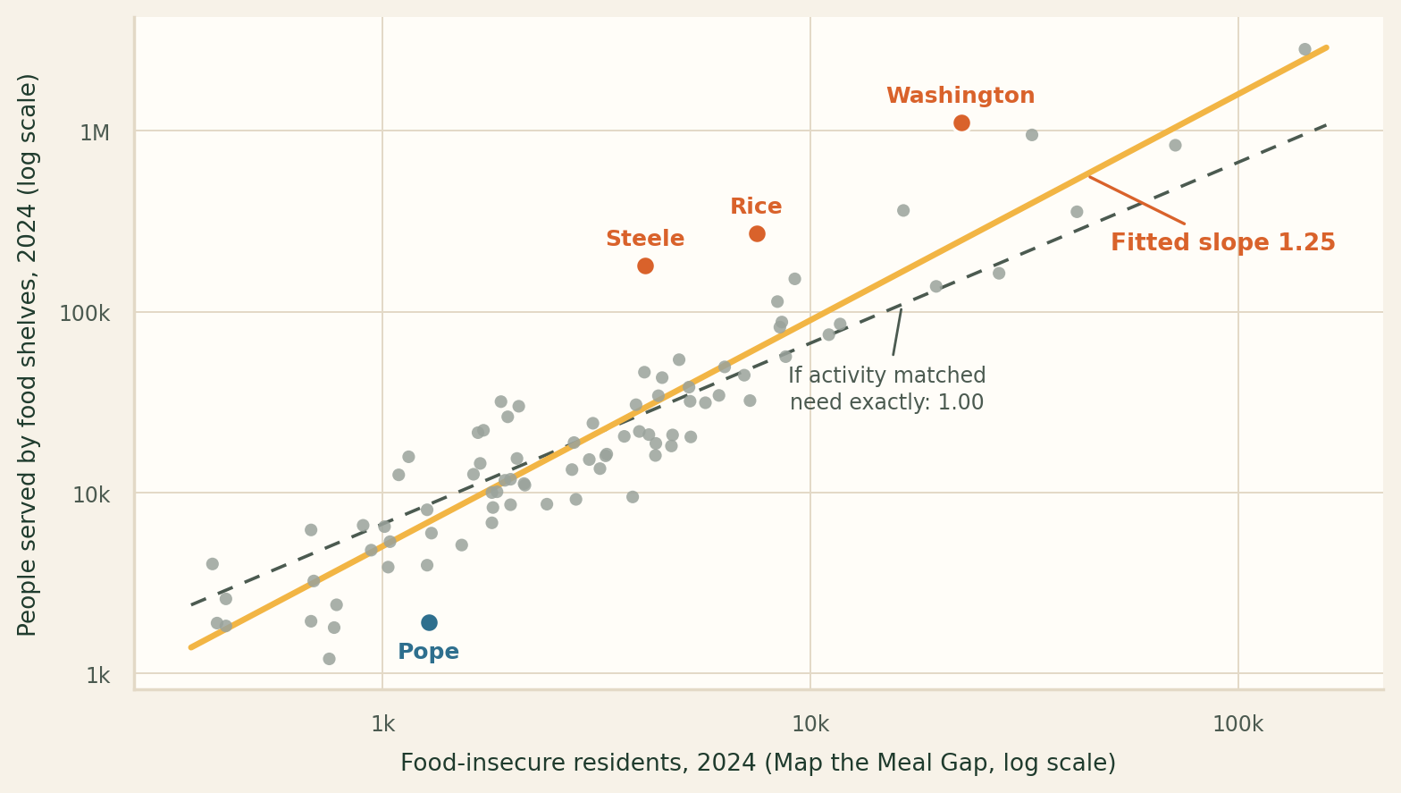
Activity only reveals county size, not need
Q1 · Need Estimates versus Food Shelf Activity
MinneMUDAC 2026 · The Food Group
0.93
Three counties serve
far more than need.
Correlation with need across 86 counties, 2024
Visits 0.93 · people 0.93 · pounds 0.94 – slope shows 1.19-1.25
3 counties
Steele, Rice and Washington counties: above need
Steele & Washington single-hub counties; Rice’s largest is 29%
Pope county
Lowest activity per food-insecure resident in the state
One shelf, reporting all 36 months on its own
So what?
Per food-insecure person, activity falls as the food-insecurity rate rises, but it points stronger to rurality instead of need. Only rurality survives when the two are separated. “Rurality” works through distance: 2.2 more miles to a shelf, 17% fewer people served than predicted.
Notes:
Q1: do Feeding America's need estimates and food shelf activity tell the same story? In totals, yes — correlation 0.93, with visits, people and pounds all within a point of each other. But that's county size. Each dot is a Minnesota county. Right is more food-insecure residents, up is more people served. Both axes are log — each gridline is ten times the last, because Hennepin has 143,000 food-insecure residents and Kittson has 400. The amber line is our fit. The dashed line is what it would look like if activity matched need exactly — slope 1.0. Ours is 1.25. Doubling a county's food-insecure population multiplies its activity by about 2.4, not 2. Steele, Rice and Washington sit far above the line. Steele and Washington we can explain, reporting above 95% and 77% share respectively. Rice we muddled — its largest site is under a third. Pope sits furthest below: one shelf, reporting every month for three years, and the lowest activity per food-insecure resident in the state.

Slide 4
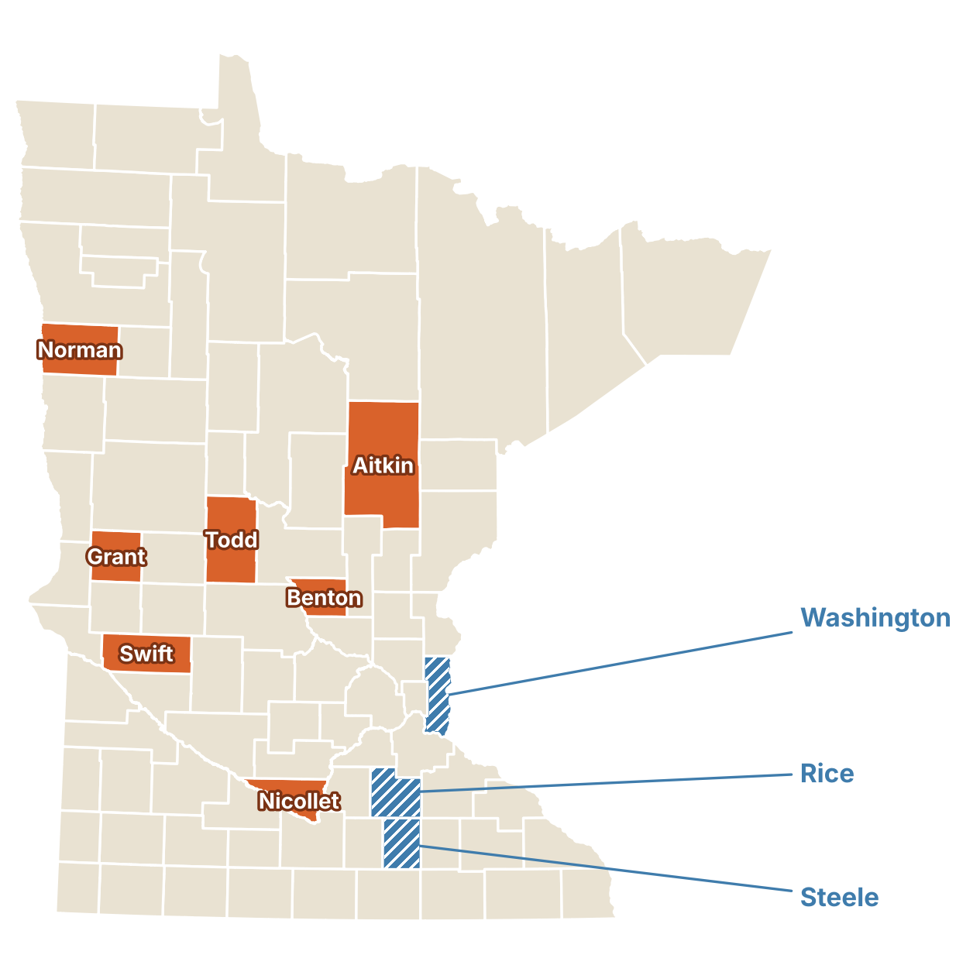
Seven counties the visit numbers don’t flag
Q6 · A Falsifiable Measure of Need
MinneMUDAC 2026 · The Food Group
7 under-served
Among the 10 most under-served in all 3 years
Swift, Grant, Todd, Benton, Aitkin, Norman and Nicollet
3 over-served
Counties within an hour of high volume Twin Cities counties
Activity far above need in all 3 years
Rice, Steele, and Washington
2 of 7
The hunger rate alone finds only Swift and Aitkin
Adding meal cost and poverty depth reveals the other five.
So what?
Allocating by visits alone sends food away from these counties: weigh the need index alongside visit counts.
Per resident, need and activity barely move together (r ≤ 0.29, near 0 by 2024); rurality is the strongest predictor of the gap.
Notes:
our own measure of need
balanced between average cost of a meal in the county,

Slide 5
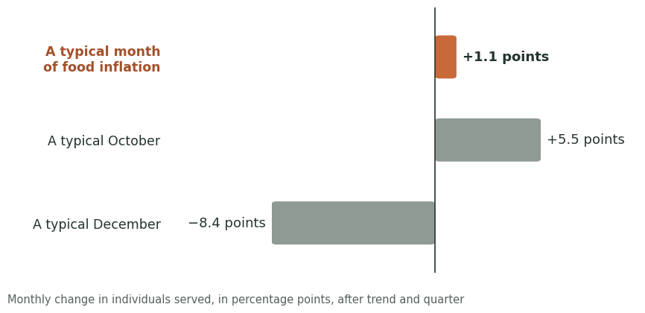
Q4 · Food Prices
MinneMUDAC 2026 · The Food Group
Plan food-shelf supply around the calendar, not grocery prices
MORE PEOPLE WHEN PRICES INCREASE?
· +1 pt food inflation ↔ +3.4 pts faster yearly
growth in people served
Prices add only
about 1 point.
AT ONCE OR DELAYED?
· Not at once, No same-month link
· Shows up over several months.
OTHER CYCLES?
Seasons move it
5 to 8 points.
· Peaks Aug, Oct, Nov
· Lows Dec - Feb
So what?
Food shelves: Plan stock and staff around the calendar.
Donors: When inflation stays high, expect demand to grow faster over the year.
Notes:
Our first conclusion: plan around the calendar, not grocery prices. (orange bar) When food prices increase, more people do come, but only modestly: about one point, building over several months, in all three metrics. (gray box) Seasons move demand far more, up about 5 pts in fall and down 8 in winter. So food shelves should plan on the calendar, and donors should expect rising need when inflation stays high.

Slide 6
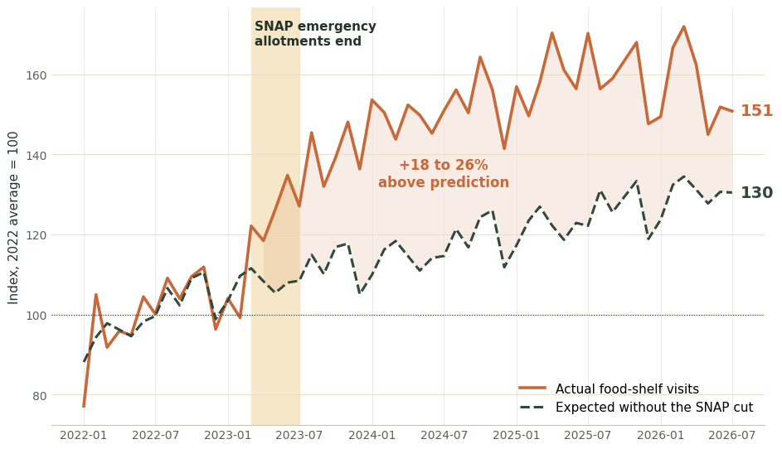
Q5 · SNAP Enrollment and Food-Shelf Use
MinneMUDAC 2026 · The Food Group
When SNAP shrinks, Minnesotans turn to food shelves
TOGETHER OR REPLACE?
· Same need across counties
· 10% less SNAP ≈ 5% more visits
Step-up in spring 2023
WHEN BENEFITS CHANGE?
· $49M/month lost
· Visits +18–26% above prediction
DIFFERENT BY PLACE?
· Same response statewide
· Rural counties lose most per resident
So what?
Lawmakers: SNAP cuts push need onto food shelves, which cannot fill the gap: each visit now carries ~¼ less food than in early 2022.
Notes:
Our second conclusion: when SNAP shrinks, Minnesotans turn to food shelves. We used the state’s DCYF SNAP dashboard, by county and month, with a one-month lag. (chart) The dashed line is what trend and prices predict; the solid line is reality. (shaded band) They split right when emergency allotments ended, a 49-million-dollar monthly cut. (151 / 130) On average since then, visits ran 18 to 26 percent above prediction; today it’s 151 versus 130.
(boxes) SNAP and food shelves track the same need, but less SNAP means more visits. This held statewide, and rural counties were hit hardest. Our message to lawmakers: food shelves cannot fill that gap.

Slide 7
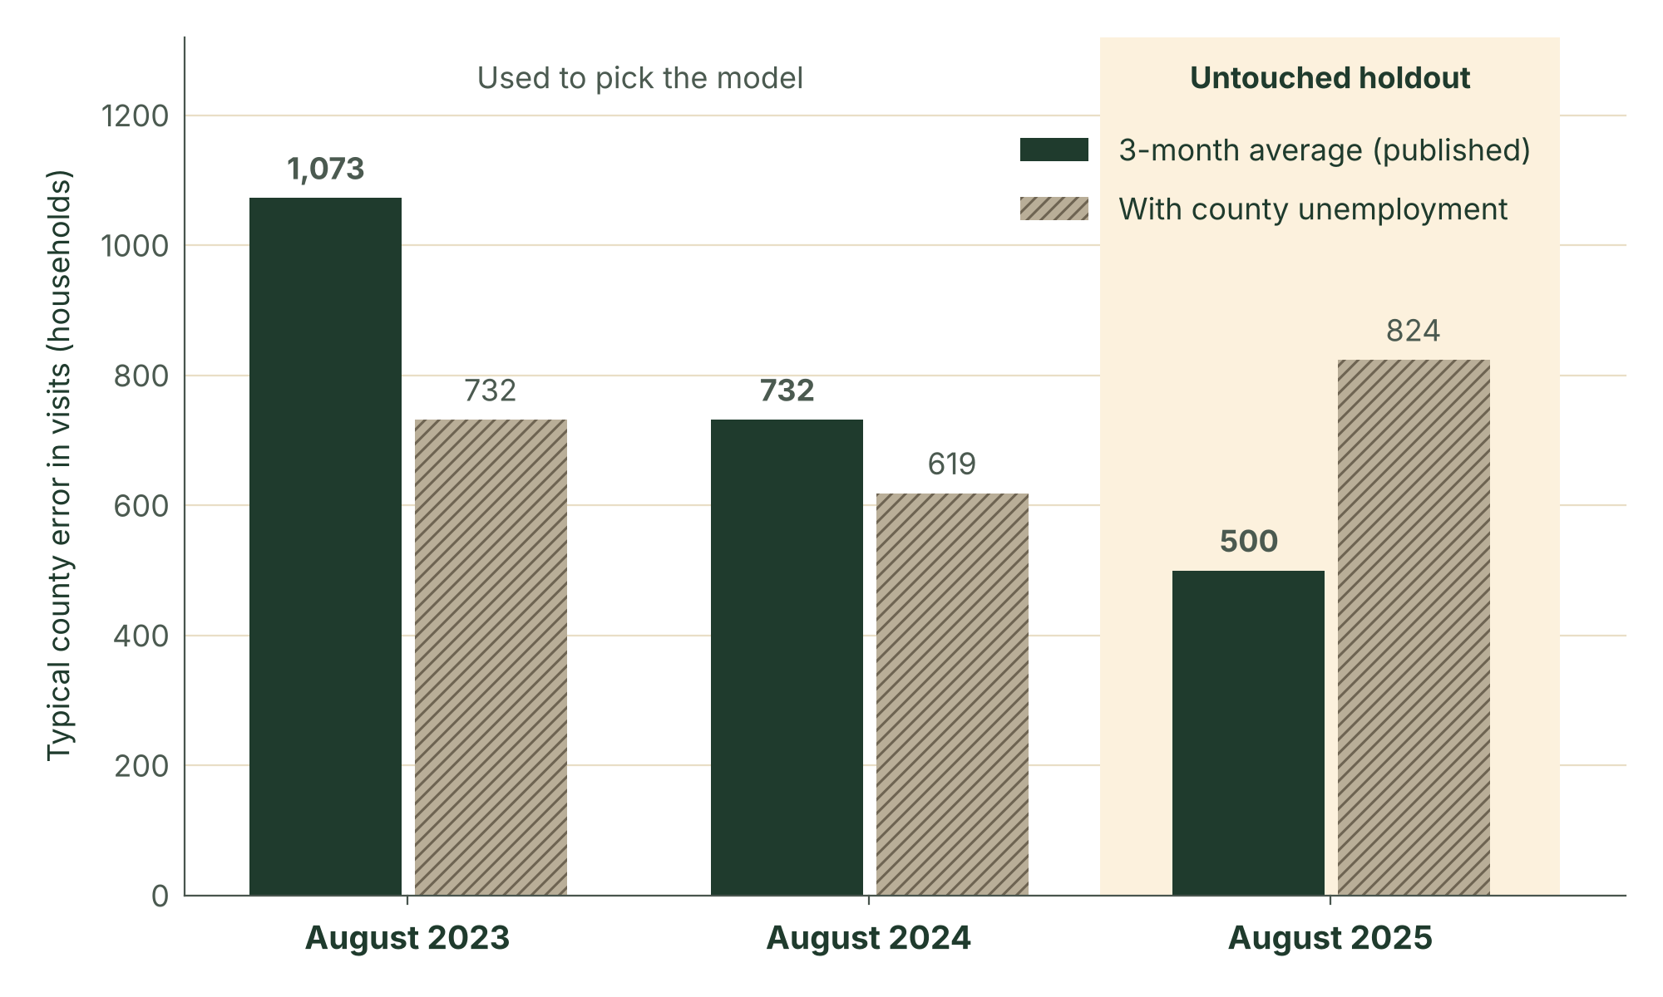
Simple three-month model beat everything we added to it
Q7 · August 2026 Forecast
MinneMUDAC 2026 · The Food Group
236,148
Visits forecast for August 2026
On the holdout,
the simple model wins:
500 versus 824.
Past Augusts ranged from 229,000 to 263,000.
5.6%
Error on statewide visits, held-back August 2025
County root-mean-squared-error: about 500 visits
12.3 million
Pounds of food; 730,000 people served
Children 258,000, adults 387,000 and seniors 85,000.
So what?
Each county's forecast is its May–July average. Adding unemployment failed the holdout, and three large counties drive most of the error.
Notes:
Bridge: once we know what moves demand, we can predict it. ~50 sec. Q7 is scored by forecast error across counties, so we built the test to match: use only data through July, predict August, compare, for three past Augusts. Why does the model say what it says? Each county's August forecast is simply its average of May, June and July. We also tried adjusting for each county's change in unemployment from the Bureau of Labor Statistics. It looked better on the two years we used to choose, then lost badly on August 2025, which we had held back as a final exam, so we did not trust it. The simple average was 5.6% off on visits. Our August 2026 forecast: about 236,000 visits statewide (range 229,000 to 263,000), 12.3 million pounds and 730,000 people. No input goes past July 2026.

Slide 8
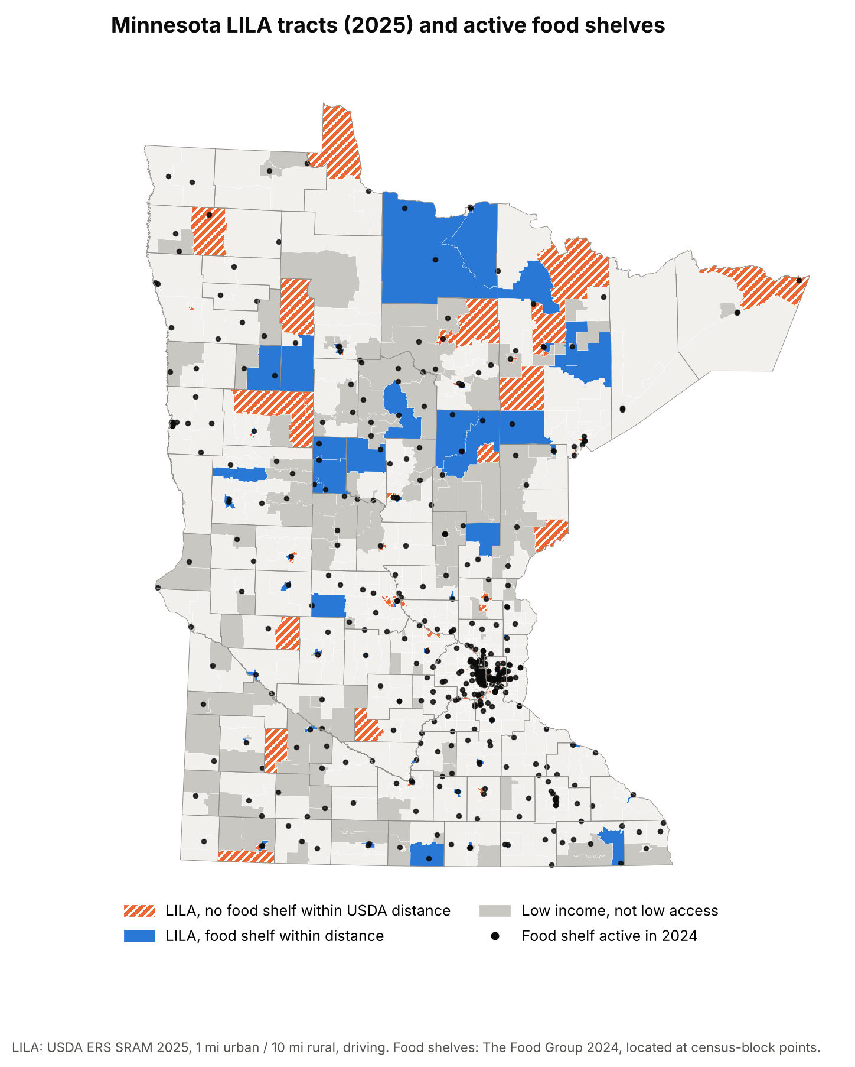
Where food shelves do not reach
Q8 · Low-Income, Low-Access Areas
MinneMUDAC 2026 · The Food Group
94 pounds
Per person a year in rural food deserts
Nearby areas get 172; tribal areas get 118, versus 280.
Rural gaps
(hatched) sit
12.6 miles from
a shelf.
89 urban gaps are
small metro tracts.
117 tracts
With no shelf within USDA distance; 57,000 people in poverty
28 are rural (12.6 miles away); 89 are urban (1.5 miles, few cars).
So what?
In rural areas, a grocery twice as far away means a shelf 76% farther; in cities there is no link. This holds in 10 of 10 tests.
Notes:
Bridge: a forecast says how many will come; Q8 asks who cannot reach a shelf at all. ~65 sec. Q8. USDA calls a census tract low-income, low-access, a food desert, when incomes are low and the nearest supermarket is more than a mile away in town or ten miles in the country. Does the food shelf network reach them? Less well: 65% of people in poverty in these tracts have a food shelf within USDA's distance, against 72% in other low-income tracts, and rural food deserts can reach 94 pounds of food a year per person, about half of other rural poor tracts. Does it fill the retail gap or repeat it? In cities there is no link. In rural Minnesota, where the grocery is twice as far, the food shelf is about 76% farther: the network repeats the retail pattern. The orange tracts are the 117 gaps: 28 rural tracts a median 12.6 miles from a shelf, and 89 urban tracts a mile and a half away where many families have no car. It holds in all ten definitions we tried. Limits: straight-line distance, partner sites only.

Slide 9
You don’t need to invest more!
You need Strategy, Execution and Monitoring.
Recommendations, Revisited
MinneMUDAC 2026 · The Food Group
1
Allocate
2
Reach
3
Advocate
4
Prepare
94
117
$49M
August
Pounds per person a year, versus 172 nearby.
Tracts with no food shelf within USDA distance.
Lost each month in 2023; 18–26% increase in visits.
October and November; 236,000 visits forecast.
Shift food to rural food deserts
Rural mobile stops; urban hours or delivery
Show what a SNAP cut does
Stock and staff for the peaks
Uses the current allocation formula.
Uses existing routes and the gap list.
Needs staff time and free DCYF data.
Needs a monthly forecast re-run.
Notes:
~40 sec. Close the loop: these are the four moves from the opening, now with the evidence the judges have just seen, and each is something The Food Group can act on with what it has today. Allocate: rural food deserts reach about 94 pounds per person a year, half of nearby areas, and the Q6 counties are the same thin rural networks, so shift pounds there and plan in pounds per person, not visits. Reach: the 117 gap tracts are two problems, a truck stop in the country and evening hours or delivery in the city; the gap list is ready to use. Advocate: we put a number on a SNAP cut, 49 million dollars a month and an 18 to 26 percent jump in visits. Prepare: August and October to November are the peaks every year; re-run the simple county forecast monthly and watch the SNAP dashboard. Close with: demand is not need.

Slide 10
Demand is not need.
MINNEMUDAC 2026 · GRADUATE DIVISION
Thank you. Questions?
Team ID: G09
Akbar · Alex · Brian · Suji · Vishesh
DATA CREDITS
The Food Group · Feeding America (Map the Meal Gap) · USDA Economic Research Service · USDA Food and Nutrition Service · U.S. Bureau of Labor Statistics · U.S. Census Bureau · Minnesota Department of Children, Youth, and Families
TEMPLATE SOURCES
Layout after "Business Proposal Ppt Template", Business Layout Lab (Pinterest, pin 1130685050261813191) · Built with Claude (Anthropic) · Fonts: Source Serif 4 and Source Sans 3 (Adobe, via Google Fonts, SIL Open Font License 1.1)
Notes:
~10 sec. Thank the judges, repeat "demand is not need", and open for questions. Point to the appendix for detail on any question.

Slide 11
Appendix contents
Appendix
MinneMUDAC 2026 · The Food Group
A
A1
Sources: competition data
A9
Q6 need index, counties
A17
Q7 model and holdout
A2
Sources: prices and SNAP
A10
Q6 falsifiable definition
A18
Q8 definition and method
A3
Sources: population, jobs
A11
Q6 drivers, robustness
A19
Q8 reach, fill or repeat
A4
Sources: food access
A12
Q4 results
A20
Q8 gap tracts
A5
Sources: geography
A13
Q4 method and checks
A21
Q8 robustness
A6
Data cleaning decisions
A14
Q5 results
A22
Limits and checks
A7
Q1 correlations, outliers
A15
Q5 tests: together or replace
A8
Q1 county characteristics
A16
Q5 tests: shock, locations
Sources A1–A5 · Cleaning A6 · Q1 A7–A8 · Q6 A9–A11 · Q4 A12–A13 · Q5 A14–A16 · Q7 A17 · Q8 A18–A21
Notes:
Not presented. Jump here during Q&A.

Slide 12
Three competition files: site activity, partner list, Map the Meal Gap
Appendix A1 · Sources: competition data
MinneMUDAC 2026 · The Food Group
A1
Publisher · exact series | Geography | Time · vintage | Why this, not an alternative | Used
The Food Group · org_FSStats: HouseholdsReg (visits), IndividualsReg, PoundsReg, Children/Adults/SeniorsReg | Food shelf site → county | Monthly, January 2022 – July 2026 | Required data; the Reg fields the brief names | All
The Food Group · Organization: partner type, status, county, 2020 census block | Site, census block | Snapshot, September 2026 | Only source of site type and location | Q1 Q5 Q8
Feeding America · Map the Meal Gap 2026 and 2025: food-insecure persons, rate, meal cost, % below SNAP limit | County (87) | Annual, 2022–2024 | Required; compared within a year, per its FAQ | Q1 Q6
CREDIT
Feeding America (2026). Map the Meal Gap 2026: county food insecurity and food cost in the United States in 2024.
Households served is the brief's visit field (about 28% of published visit totals)
Notes:
Appendix A1, backup for Q&A. Households served is the brief's visit field and equals about 28% of The Food Group's published visit totals, so we report changes, not absolute visits.

Slide 13
Monthly Midwest food CPI and county SNAP data, trimmed to July 2026
Appendix A2 · Sources: prices and SNAP
MinneMUDAC 2026 · The Food Group
A2
Publisher · exact series | Geography | Time · vintage | Why this, not an alternative | Used
U.S. Bureau of Labor Statistics via FRED · CPI-U Food at Home, Midwest Urban (CUUR0200SAF11), not seasonally adjusted | Census Midwest region | Monthly to July 2026; about a 2-week lag | Minneapolis CPI is only bimonthly | Q4 Q5
Minnesota Department of Children, Youth, and Families · SNAP Food Assistance Dashboard: cases, persons, net benefits | County or Tribal Nation (88) | Monthly, 2016 – July 2026; about a 1-month lag | Monthly and county-level; DHS reports are annual | Q5
Minnesota DCYF · Same dashboard, statewide totals | Statewide | Monthly, 2016 – July 2026 | Checks county sums; statewide time series | Q5
NO AUGUST DATA
Both downloads ran into August 2026 and were trimmed to July before loading (accessed 2026-09-28).
fred.stlouisfed.org/series/CUUR0200SAF11 · dcyf.mn.gov/snap-food-assistance-minnesota
Notes:
Appendix A2, backup for Q&A. SNAP source, grain and lag as Q5 asks: DCYF dashboard, county or Tribal Nation by accounting month, about one month lag. Tribal Nations are folded into Mille Lacs, Beltrami and Mahnomen.

Slide 14
Census population sets per-resident rates; BLS unemployment was rejected
Appendix A3 · Sources: population, jobs
MinneMUDAC 2026 · The Food Group
A3
Publisher · exact series | Geography | Time · vintage | Why this, not an alternative | Used
U.S. Census Bureau, Population Estimates Program · County Population Totals, Vintage 2025 | County (87) | Annual (July 1); released March 2026 | Latest official count each year; ACS 5-year lags | Q1 Q5 Q6
U.S. Bureau of Labor Statistics · Local Area Unemployment Statistics, county rate (LAUCN27…03) | County (87) | Monthly, 2022 – July 2026 | Only monthly county labor series; tested, then rejected | Q7
LINKS
census.gov/data/tables/time-series/demo/popest/2020s-counties-total.html (accessed 2026-10-09) · api.bls.gov, LAUS (accessed 2026-10-11)
Unemployment rows after July 2026 dropped before use
Notes:
Appendix A3, backup for Q&A. Census population turns counts into rates per 1,000 residents. BLS county unemployment was tried as a Q7 input and rejected on the holdout year.

Slide 15
USDA's 2025 access map defines food deserts; the 2019 Atlas checks it
Appendix A4 · Sources: food access
MinneMUDAC 2026 · The Food Group
A4
Publisher · exact series | Geography | Time · vintage | Why this, not an alternative | Used
USDA Economic Research Service · Food Access Research Atlas 2019: LILA flags (1 & 10, ½ & 10, 1 & 20, vehicle) | 2010 tract → 2020 | 2010 Census, ACS 2014–2018, 2019 stores | The brief's named source; kept as a check | Q8
USDA ERS · SNAP-Authorized Retailer Access Map 2025: driving and straight-line LILA flags, tract traits | 2020 tract (1,502) | 2020 Census, ACS 2020–2024, 2025 stores | Current, 2020 tracts, driving distance | Q8 Q1
USDA Food and Nutrition Service · Historical SNAP Retailer Locator 2005–2025 | Store point | Snapshot, 1 July 2024 | Dated list matching 2024 activity | Q8
Definition and pipeline in Appendix A18
Notes:
Appendix A4, backup for Q&A. Main LILA flag: SRAM 2025, driving distance, 1 mile urban and 10 miles rural. The 2019 Atlas, which the brief names, is the check.

Slide 16
Census population centers and block crosswalks place every tract and shelf
Appendix A5 · Sources: geography
MinneMUDAC 2026 · The Food Group
A5
Publisher · exact series | Geography | Time · vintage | Why this, not an alternative | Used
U.S. Census Bureau · 2020 Centers of Population by tract | Tract point | 2020 Census | Where people live, not a tract's middle | Q8
U.S. Census Bureau · 2010–2020 Tabulation Block Relationship File, Minnesota | Census block | 2010 to 2020 | Moves the 2019 Atlas to 2020 tracts | Q8
U.S. Census Bureau · TIGER/Line 2024: tracts and 2020 tabulation blocks | Tract, block | 2024 release | Locates shelves; draws the maps | Q8 Q6
Crosswalk weighted by shared land area
Notes:
Appendix A5, backup for Q&A. The crosswalk uses shared land area because block populations for both vintages are not in the relationship file.

Slide 17
9 cleaning rules; one Waseca entry alone would have faked a statewide spike
Appendix A6 · Data cleaning decisions
MinneMUDAC 2026 · The Food Group
A6
Issue | Decision | Affects
Date of record | DateForSearch used; _Year/_Month disagree on 26 rows | All
63 duplicate site-months | Keep the larger row, never sum (matches each site's normal month) | All
Waseca, July 2023 | 273,385 households for 646 people → 311, midpoint of June and August | Q1 Q6
98 impossible rows | Households above individuals rebuilt from the site's ratio | All
Split county labels | Hennepin and Ramsey sub-labels mapped to their county | All
Unlocatable sites | 39 sites flagged, not dropped; about 1% of activity has no county | Q1 Q6 Q8
Coverage gaps | Becker, Beltrami under 35% coverage; Wilkin has no rows | Q1 Q6
USDA 2025 low-income count | Fails a consistency check (r = −0.80 with poverty); not used | Q8
County label vs census block | Sites 1066 and 1261 labeled Hennepin in Jan 2024; city and block FIPS disagree. 1066 Relabeled to Anoka and 1261 to Scott; Q7 keeps the reported field | Q1 Q6
Waseca entry, duplicates and the Wilkin gap to be flagged to The Food Group * Q4 rebuilds bad household rows from each site’s ratio; Q5 sets >10× spikes to missing and keeps the latest duplicate; Q7 uses the reported field as received
Notes:
Appendix A6, backup for Q&A. The Waseca unit error alone would create a fake statewide spike. Per the code of conduct, operational data problems go back to The Food Group, assuming positive intent.

Slide 18
All 3 metrics correlate 0.93–0.94 with need in totals, but not per resident
Appendix A7 · Q1 correlations, outliers
MinneMUDAC 2026 · The Food Group
A7
Metric, 86 counties, 2024 | r (log scale)
Pounds distributed | 0.94
Individuals served | 0.93
Household visits | 0.93
PER 1,000 RESIDENTS
The link disappears
Higher food-insecurity rates do not bring higher visit rates.
Steele County
Actual 1,588 versus predicted 358 visits per 1,000 (t = 6.1); one hub provides 95%.
READ IT CAREFULLY
Strong in all three years, but mostly county size: big counties have more of everything.
Wilkin County
810 food-insecure residents and no food shelf records at all.
Feeding America, Map the Meal Gap 2025–2026; The Food Group 2022–2024 · Team notebook Q1_clean_and_analysis
Notes:
Appendix A7, backup for Q&A. All three metrics correlate about 0.93 to 0.94 with Feeding America counts, pounds slightly strongest. That is mostly size; per resident the link is weak. The outliers are about the network: regional hubs and missing coverage.

Slide 19
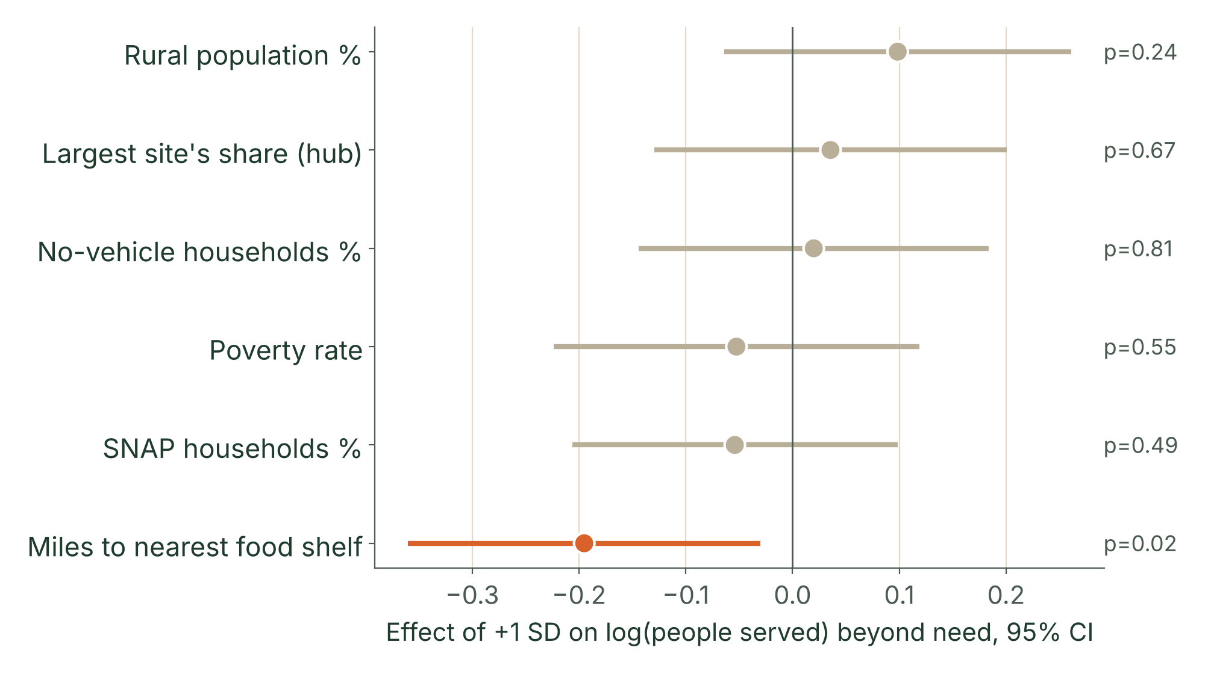
Only distance matters: 2.2 more miles to a shelf, 17% fewer served than need
Appendix A8 · Q1 county characteristics
MinneMUDAC 2026 · The Food Group
A8
PER 2.2 MORE MILES (1 STANDARD DEVIATION)
−17%
People served versus need, p = 0.03
METHOD
Residual of log people served on log food-insecure persons, on six z-scored traits; robust standard errors; 86 counties, 2024
The only significant trait.
READING
R² = 0.10: county traits explain little; most mismatch is site-level (hubs, coverage)
USDA ERS Retailer Access Map 2025 tract traits (population-weighted); Q8 distances; Map the Meal Gap 2026
Notes:
Appendix A8, backup for Q&A. Q1 asks for county characteristics. Poverty, SNAP share, no-vehicle share, rural share and hub concentration are not significant; distance to the nearest shelf is.

Slide 20
Need index flags 7 counties under-served and 3 counties over-served
Appendix A9 · Q6 need index, counties
MinneMUDAC 2026 · The Food Group
A9
Need index
Divergence
Average of three within-year z-scores from Map the Meal Gap: food-insecurity rate, cost per meal, share of food-insecure people below the SNAP limit
Demand index (visits, people, pounds per 1,000) minus need index, for every county in 2022, 2023 and 2024
NEED ABOVE ACTIVITY, ALL 3 YEARS
ACTIVITY ABOVE NEED
Swift, Grant, Todd, Benton, Aitkin, Norman and Nicollet
Rice, Steele and Washington
Swift has one food shelf and the most rural code in the state.
Steele and Washington are single-hub counties (95% and 77%). Rice’s 2023-2024 jump is two sites that opened mid-2023 and closed in August 2024– a third of its activity.
Feeding America, Map the Meal Gap 2022–2024; Census population · Team notebook Q6_need_divergence
Notes:
Appendix A9, backup for Q&A. Wadena and Chippewa also rank under-served in 2 of 3 years. Wilkin cannot be scored: it has need but no rows at all.

Slide 21
Need index passes its own test: the food-insecurity rate explains only 52%
Appendix A10 · Q6 falsifiable definition
MinneMUDAC 2026 · The Food Group
A10
Addendum item | Our answer
1 · Definition | Need = average of within-year z-scores of three Map the Meal Gap county measures: food-insecurity rate, cost per meal, and share of food-insecure people below the SNAP income limit.
2 · Need, not demand | No input comes from food shelf activity; Map the Meal Gap models need from Census survey data and county economics. Demand enters only at the comparison.
3 · Reject it if | It adds nothing beyond the food-insecurity rate. Tested, not rejected: the rate explains 52% (r = 0.72); meal cost and poverty depth add the rest.
4 · Revise it if | The Food Group defines need to include access, or an outside source moves counties a lot. Rurality and shelf density act as explanations, so they stay outside.
Team notebook Q6_need_divergence, section 6
Notes:
Appendix A10, backup for Q&A. The four items the addendum requires, stated plainly. The index is an extension of the food-insecurity rate, not a replacement.

Slide 22
Rurality best predicts hidden need; ranks hold (r ≥ 0.81) across 5 weightings
Appendix A11 · Q6 drivers, robustness
MinneMUDAC 2026 · The Food Group
A11
DRIVERS · 258 COUNTY-YEARS
WEIGHTING CHECK · 5 VERSIONS
Rurality
Mostly Stable
−0.140 per step on the 1–9 scale (p < .001);
shelves per 10,000 food-insecure + 0.013 (p = .04); R² = 0.13
Rank correlation 0.81–0.98; the rural cluster keeps 6–9 of 9 counties when a part is dropped, 4 of 9 on the rate alone
Swift and Aitkin stay under-served under every weighting; five of the nine drop out on FI rate alone
NEED VS EACH ACTIVITY METRIC, PER 1,000 RESIDENTS
Correlations run from −0.12 to 0.29 across 2022–2024, while the three activity metrics agree with each other (0.85–0.96). Activity is consistent; it just does not follow need.
Standard errors clustered by county · Team notebook Q6_need_divergence, sections 2b, 4b, 4c
Notes:
Appendix A11, backup for Q&A. Rurality is the strongest driver of hidden need; shelf density adds a little. The extra components matter: on the food-insecurity rate alone, five of the nine cluster counties drop out.

Slide 23
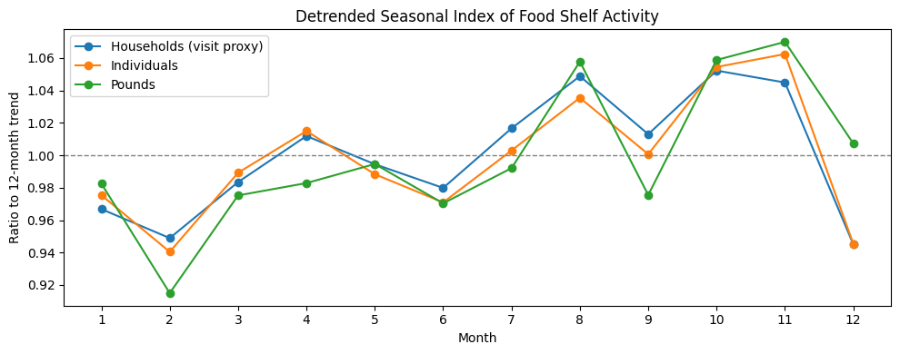
Prices add 1 point, seasons 5–8 points; the SNAP cut 16–19 points over trend
Appendix A12 · Q4 results
MinneMUDAC 2026 · The Food Group
A12
Typical monthly price rise (+0.22%)
≈ +1 point
Prices have the smallest effect.
Per month
Seasonal swing (August and fall peaks)
±5 to 8 points
SNAP allotments end (Spring 2023)
+16 to 19 points
Same month
Over a year
Donor number
No effect: r ≈ 0 once the shared trend is removed
Move together (r 0.33–0.55); no precise lag survives the falsification test
One point of food inflation ≈ 3.4 points faster growth in people served (95% interval 2.2–4.6)
month / year | Oct | Dec
2022 | -3.0 | -10.8
2023 | 6.9 | -7.9
2024 | 8.0 | -7.0
2025 | 10.0 | -8.1
+1.1: result of multiplying the CPI lag-1 coefficient (4.95) by the typical monthly CPI growth rate (median 0.224%). 4.95 × 0.224 = 1.11 pp.
+5.5 / −8.4: averaged residuals from the same model for Oct and Dec, respectively. Specifically, they are +5.46 and −8.43. A residual represents the movement remaining after accounting for price and quarterly factors.
(All units are expressed in percentage points (pp) of the monthly growth rate.)
BLS CPI-U Food at Home, Midwest Urban, via FRED; The Food Group · Team notebook Q4_FINAL
Notes:
Appendix A12, backup for Q&A. Answer Q4 directly: yes, modestly; not at once; the calendar and SNAP shocks are bigger. Activity peaks in August and October to November every year.

Slide 24
People served responds to prices most reliably; pounds least
Appendix A13 · Q4 method and checks
MinneMUDAC 2026 · The Food Group
A13
DATA
METHOD
FALSIFICATION
Statewide monthly totals, January 2022 – July 2026 (55 months), versus Midwest food-at-home CPI
Detrended monthly changes; lag correlations −3 to +3 months; yearly growth; calendar effects
Activity leading CPI by 2 months correlates as strongly, so no fixed delay is claimed
Metric | Response to prices
Individuals | Strongest: one-month lag significant in every check, including the fixed-site panel
Households | Present in full data; weakens in the fixed-site panel
Pounds | Weakest: pounds is also supply, and prices cut what shelves can buy
Checks: fixed sites; mobile, Tribal, campus sites added; missing pounds imputed; late reporting
Notes:
Appendix A13, backup for Q&A. Individuals respond most consistently; pounds least, because pounds reflects supply as well as demand.

Slide 25
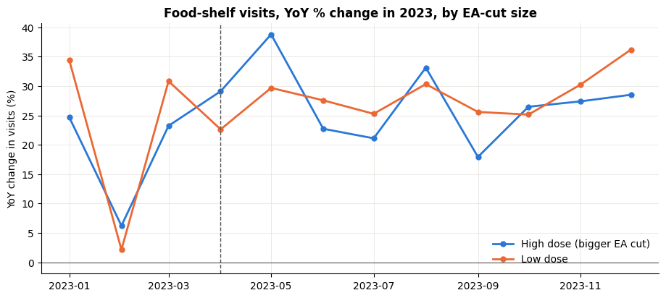
SNAP fell $49M a month; visits ran 18–26% over trend, ¼ less food each
Appendix A14 · Q5 results
MinneMUDAC 2026 · The Food Group
A14
+18–26%
ACROSS COUNTIES
EMERGENCY ALLOTMENTS END
+1% SNAP participation → +0.30% visits (p = .01): both follow need
$49M a month
Visits above prediction
Lost (−41%); benefit per person fell from $260 to $160
−10% → +5%
FOOD PER VISIT
Visits doubled, pounds +50%: about ¼ less food each
Less SNAP per person, more visits
26% from Spec A / 18% from Segmented Model
LOCATIONS
No metro difference; small counties lost most per resident
 | Visits | Individuals | Pounds
Spec A: step, permanent | +25.7% (p<.001) | +30.0% (p<.001) | +17.5% (p<.001)
Segmented: step, trend may bend | +17.6% (p=.009) | +25.9% (p=.003) | +14.1% (p=.012)
Post-cut slope (per month) | -1.3% (p=.16) | -0.6% (p=.60) | -0.6% (p=.54)
Spec B: elasticity to benefit/person | -0.50 | -0.58 | -0.35
All models: log outcome ~ trend + log food CPI + month dummies; HAC SE; 54 months
High- and low-cut counties rose together: the response was statewide.
Minnesota DCYF SNAP dashboard; BLS CPI; Census Vintage 2025; The Food Group 2022–2026 · Team notebook Q5_FINAL
Notes:
Appendix A14, backup for Q&A. Move together or replace? Both: across counties they rise together because both follow need; over time SNAP money replaces food shelf trips.

Slide 26
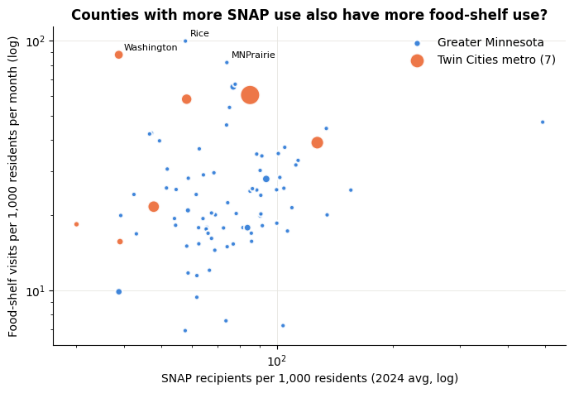
Across counties SNAP and shelves rise together; over time they substitute
Appendix A15 · Q5 tests: together or replace
MinneMUDAC 2026 · The Food Group
A15
Test | Specification | Result
Across counties | Log SNAP participation versus shelf rates per 1,000 | +1% → +0.30% visits (p = .01), +0.30% individuals, +0.22% pounds
Over time | Statewide benefit per person; trend, CPI, season controlled | 10% lower benefit → +5% visits, +6% individuals, +3.5% pounds
Within county | County fixed effects, balanced versus all sites | Sign flips between samples: not interpreted
Same Response Statewide
Rural Counties Lose Most per Resident
Test | Result
Metro vs. Greater MN interaction | Not significant (p = 0.15 - 0.74)
Dose-response: EA loss per resident ($3–$18) | Coefficient ≈ 0 (+0.03 per $5, p = 0.71)
Difference in slope by county size | Not significant (p = 0.24 - 0.30)
County Size | Loss per Capita (median/month) | Change in Visit Growth Rate
Small (<20k) | $9.90 | +16.5pp
Mid (20k–100k) | $8.93 | +7.3pp
Large (≥100k) | $6.19 | +10.3pp
Team notebook Q5_FINAL, sections 5–6 and 8
Notes:
Appendix A15, backup for Q&A. Together across places, replacing over time; no robust month-to-month link inside one county.

Slide 27
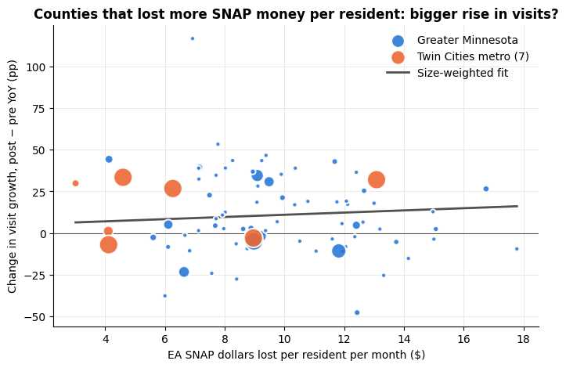
Placebo picks spring 2023 as the break; small counties lose most per resident
Appendix A16 · Q5 tests: shock, locations
MinneMUDAC 2026 · The Food Group
A16
Test | Specification | Result
Benefit change | Interrupted time series at the April 2023 end of emergency allotments, CPI-controlled | Visits +18–26%, individuals +26–30%, pounds +14–18%
Placebo | Try a break at every month, mid-2022 to mid-2025 | Best four fits: March–June 2023
Dose-response | Emergency-allotment dollars lost per resident ($3 to $18) | About 0 (p = .71): the rise was statewide
Locations | Metro interactions; small, mid, large counties | No metro gap (p .15–.74); small counties hit hardest
<Prediction vs. Actual Chart>
Monthly visits from a balanced panel of 361 sites (reporting in over 90% of months) were aggregated statewide + The Midwest food-at-home CPI was added; Period: Jan 2022 – July 2026
Model (Interrupted Time Series): ln(visits) = trend(t) + EA termination dummy (1 for April 2023 onwards) + ln(CPI) + month dummies (seasonality); HAC standard errors.
Solid line: Actual visits.
Dashed line: Predicted values ​​from the same model with the EA dummy set to 0 (while retaining the trend, actual price levels, and seasonality). → the trajectory "had there been no SNAP reduction."
Index: each month ÷ 2022 monthly average × 100; households ≈ 28% of published visits
(show change, not levels)
Minnesota DCYF SNAP dashboard (county × month, lag ≈ 1 month) · Team notebook Q5_FINAL
Notes:
Appendix A16, backup for Q&A. How we know it was SNAP and not prices: CPI is controlled, prices were flat after April 2023, and the placebo scan picks March to June 2023.

Slide 28
Unemployment model won selection, then lost the holdout (824 versus 500)
Appendix A17 · Q7 model and holdout
MinneMUDAC 2026 · The Food Group
A17
Target | Selection error | 2025 holdout error | % error | Range hit | August 2026 forecast (past range)
Visits | 902 / 676 | 500 / 824 | 5.6% | 88% | 236,148 (229,000–263,000)
Pounds | 46,950 / 47,299 | 61,245 / 59,372 | 11.1% | 66% | 12.26 million (12.47–13.70 million)
Children | 1,331 / 1,093 | 269 / 615 | 4.1% | 77% | 258,020 (260,000–294,000)
Adults | 1,584 / 1,320 | 525 / 1,095 | 4.5% | 84% | 386,891 (377,000–434,000)
Seniors | 257 / 214 | 392 / 340 | 8.7% | 81% | 85,216 (85,000–94,000)
Individuals | 3,030 / 2,462 | 575 / 1,541 | 3.3% | 81% | 730,121 (723,000–822,000)
MODEL
DECISION RULE
ALSO CHECKED
Each county's May–July 2026 average; Wilkin, with no site, forecast at 0
Unemployment won 5 out of 6 picks, then lost 4 on the holdout, so it was rejected.
An August seasonal factor made 4 of 6 targets worse. A uniform August multiplier, fit on prior years, made county RMSE worse in 10 of 12 backtests. Both were trying to model one event: 88% of our 2025 pounds error is one Ramsey site’s single month.
Errors are county root-mean-square error (RMSE) · Team script forecast_august.py; backtest_metrics.csv; summary.json
Notes:
Appendix A17, backup for Q&A. If asked why not fancier: unemployment looked better on the years used to choose and lost on the held-back year, which is the overfitting the holdout exists to catch. Pounds is hardest: 11% error, because pounds also depends on supply; past Augusts ran above the May–July average, so its range sits above the point.
Two sites were relabeled to Hennepin in January 2024. We forecast the reported field, so the labels are left as-is; the three-month model never spans the break.

Slide 29
141 food-desert tracts, tested for reach, food supply and fill-or-repeat
Appendix A18 · Q8 definition and method
MinneMUDAC 2026 · The Food Group
A18
USDA LILA DEFINITION
Pipeline · 1,502 tracts
Low income: poverty ≥ 20%, or family income ≤ 80% of the area median. Low access: 500+ people or 33% live over 1 mile (urban) or 10 miles (rural) from a supermarket.
Food shelves active in 2024 at their census-block point · Groceries = supermarket, super store or large grocery on 1 July 2024 · Straight-line miles from where residents live · Capacity = pounds within 10 miles per person in poverty, two-step catchment · Compared with low-income tracts that are not low-access · Fill or repeat = weighted log–log slope with a density control
VINTAGES
Main: Retailer Access Map 2025, driving: 141 tracts.
Check: Food Access Atlas 2019: 164 tracts.
USDA ERS; USDA FNS; Census 2020 centers of population · Team notebooks Q8_01 and Q8_02
Notes:
Appendix A18, backup for Q&A. Comparison group holds income roughly constant, so the difference is grocery access. The two-step catchment avoids double-counting a shelf shared by several tracts.

Slide 30
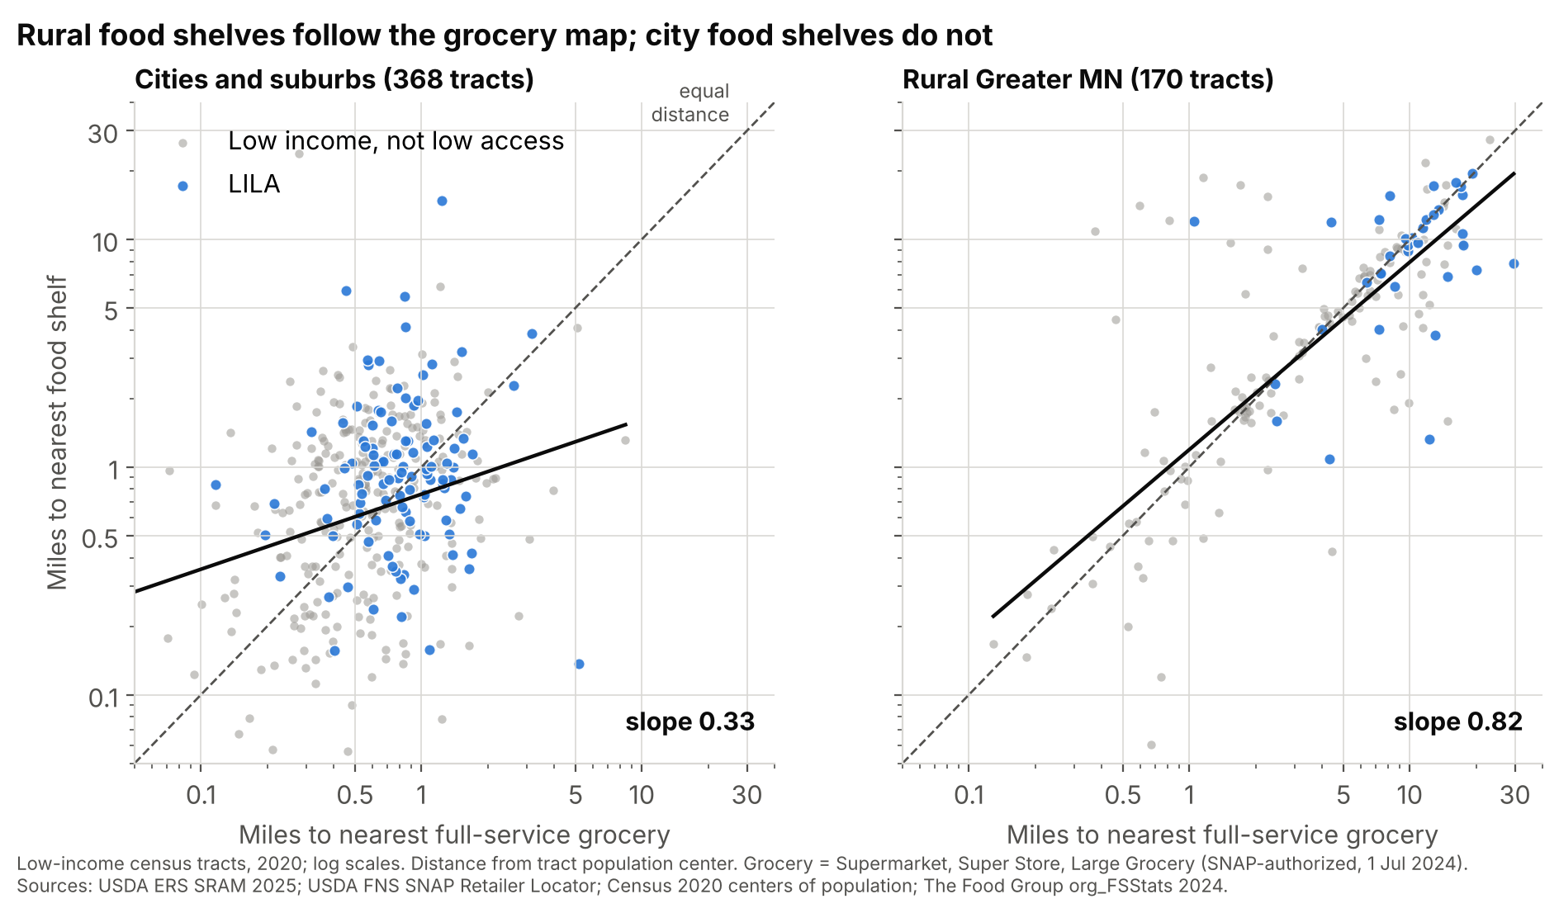
Rural shelves follow grocery distance (0.82); city shelves do not (0.33)
Appendix A19 · Q8 reach, fill or repeat
MinneMUDAC 2026 · The Food Group
A19
65%
versus 72%
People in poverty within USDA distance of a shelf
241
versus 290 pounds
Food reachable per person a year (within 10 miles)
0.82
Rural slope
0.55 with a density control; cities 0.07–0.33
Weighted by people in poverty; comparison = low-income, not low-access tracts
Notes:
Appendix A19, backup for Q&A. Slope 1 means the network repeats the retail map; 0 means independent; below 0 means it fills the gap. Rural Minnesota is close to repeating.

Slide 31
28 rural gap tracts sit 12.6 miles from a shelf; 89 urban ones lack cars
Appendix A20 · Q8 gap tracts
MinneMUDAC 2026 · The Food Group
A20
URBAN · 89 TRACTS
RURAL · 28 TRACTS
48,000
12.6 miles
People in poverty; shelf 1.5 miles away, few cars
Median distance to a shelf; up to 27 miles in Beltrami
Rural gap
tracts
Rural food-desert tracts
Reach 94 pounds per person a year, versus 172 in other rural low-income tracts.
Urban gap
tracts (metro)
Tribal areas
118 pounds versus 280 elsewhere (tribal food programs are not in this data).
St. Cloud
Holds 5 of the 15 largest gap tracts.
Gap list: q8_gap_tracts.csv (LILA 2025 or 2019, no shelf within 1 mile urban / 10 miles rural)
Notes:
Appendix A20, backup for Q&A. Two problems: a mobile stop in the country, hours, delivery or transit in the city. The gap list is ranked by people in poverty.

Slide 32
Food deserts trail on reach in 10 of 10 definitions, on food in 9 of 10
Appendix A21 · Q8 robustness
MinneMUDAC 2026 · The Food Group
A21
Variant | LILA tracts | Near a shelf: LILA versus other | Pounds per person
Main: 2025, 1 and 10 miles, driving | 141 | 65% versus 72% ✓ | 241 versus 290 ✓
2025, straight-line | 49 | 50% versus 71% ✓ | 193 versus 283 ✓
2025, ½ and 10 miles | 291 | 58% versus 86% ✓ | 271 versus 284 ✓
2025, 1 and 20 miles | 106 | 66% versus 71% ✓ | 262 versus 281 ✓
2025, vehicle access | 104 | 65% versus 72% ✓ | 288 versus 271 ✗
2019 Atlas (brief's source) | 164 | 60% versus 74% ✓ | 226 versus 298 ✓
Fixed sites only | 141 | 63% versus 69% ✓ | 241 versus 290 ✓
Capacity within 5 miles | 141 | 65% versus 72% ✓ | 260 versus 279 ✓
Capacity within 20 miles | 141 | 65% versus 72% ✓ | 249 versus 291 ✓
Weights: 2019 low-income | 141 | 61% versus 70% ✓ | 93 versus 125 ✓
Team notebook Q8_02, section 4; q8_robustness.csv · The vehicle-access definition reverses capacity
Notes:
Appendix A21, backup for Q&A. The coverage gap appears every time; capacity reverses only under the vehicle-access definition. The 2019 Atlas gives the same answer.

Slide 33
Five limits we name, and five checks that tried to prove us wrong
Appendix A22 · Limits and checks
MinneMUDAC 2026 · The Food Group
A22
Limits
CHECKS
• Households served are not visits (about 28% of published totals)
• Partner network only; 39 sites unlocated
• Straight-line distance, not drive time
• One big SNAP shock to learn from
• Meal cost not comparable before 2023
• Q4: The lag failed falsification, so it is not claimed.
• Q5: The placebo test picks spring 2023.
• Q6: The index beats the rate alone.
• Q7: The holdout year rejected the fancier model.
• Q8: Results hold in 10 of 10 definitions.
Cleaning decisions in Appendix A6
Notes:
Appendix A22, backup for Q&A. Judges reward honesty about limits. Left: what our data cannot tell you. Right: how we tried to prove ourselves wrong.

